Slide 1
Basic Of Shell Scripting II

Slide 2
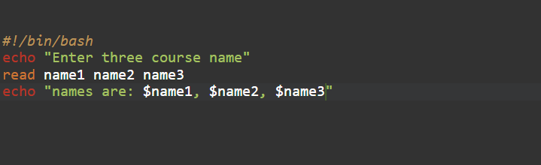
read Command
Syntax for taking multiple user input using read keyword.

Slide 3
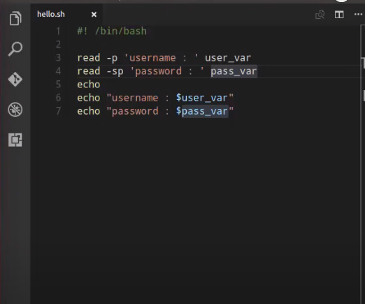
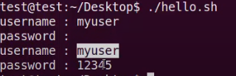
Example

Slide 4
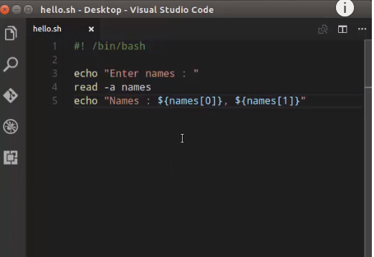
Example

Slide 5
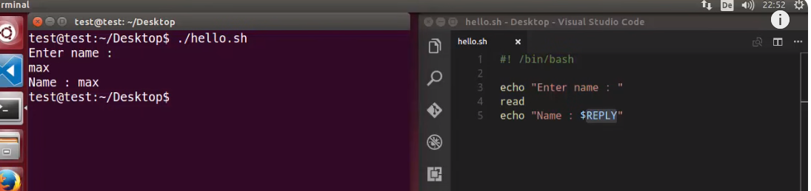
Example

Slide 6
Adding Basic Options
Let’s take a look at some of the most basic options we can use:
-a array: stores the results of the word split operation in an array rather than separate variables
-s: does not echo the input line to the standard output stream
–p prompt: print the prompt text before requesting the input from the standard input stream without a <newline> character
-t timeout: attempt to read the input for a given period of seconds
–N: read exactly N characters from the input unless a timeout occurs or EOF is reached

Slide 7
Conditional Statement
If-else Statement #
Bash if conditionals can have different forms. The most basic if statement takes the following form:
if TEST-COMMAND
then
STATEMENTS
Else
STATEMENTS
fi
The if statement starts with the if keyword followed by the conditional expression and the then keyword. The statement ends with the fi keyword.

Slide 8
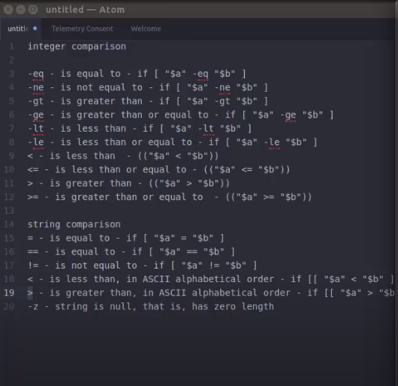
Syntax

Slide 9
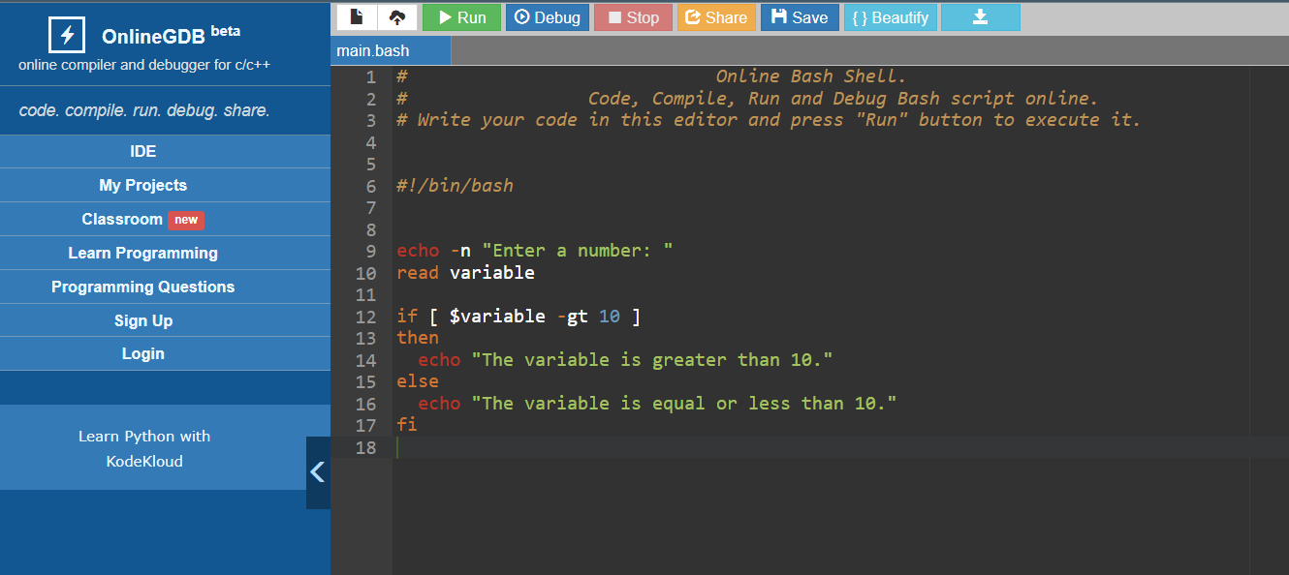
Example Code

Slide 10
if..elif..else Statement
if TEST-COMMAND1
then
STATEMENTS1
elif TEST-COMMAND2
then
STATEMENTS2
else
STATEMENTS3
fi
If the TEST-COMMAND1 evaluates to True, the STATEMENTS1 will be executed. If the TEST-COMMAND2 evaluates to True, the STATEMENTS2 will be executed. If none of the test commands evaluate to True, the STATEMENTS2 is executed.

Slide 11
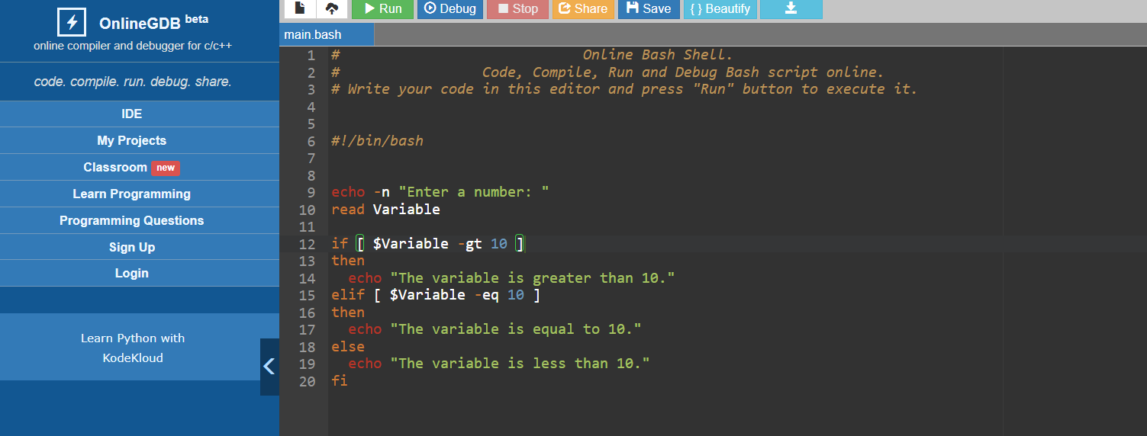
Example Code

Slide 12
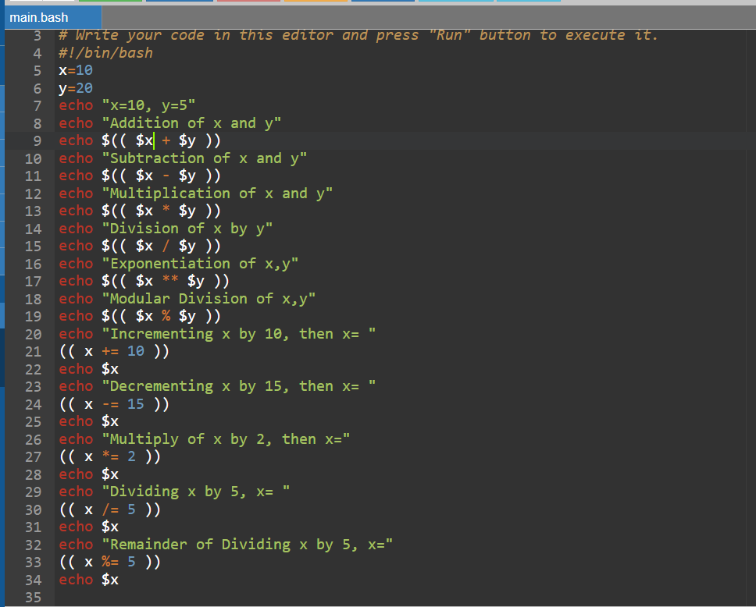
Arithmetic Operation

Slide 13
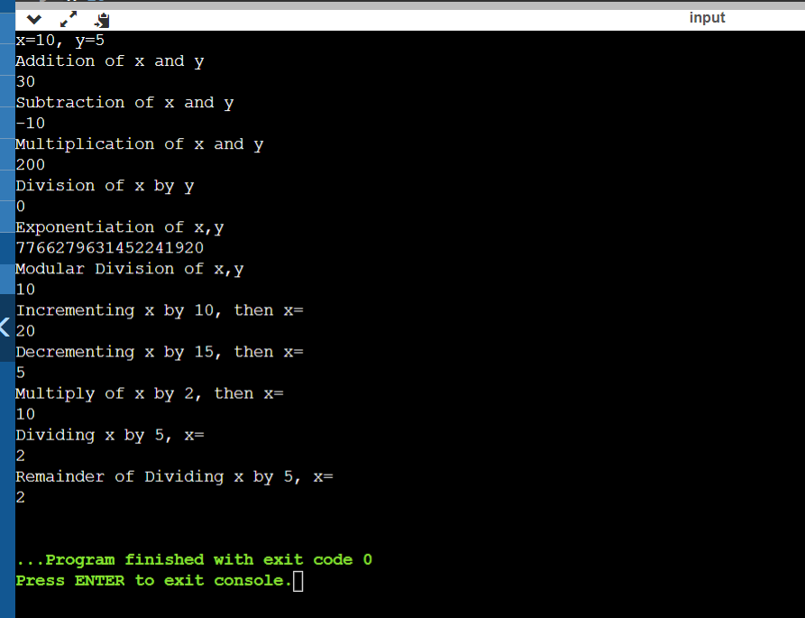
Arithmetic Operation

Slide 14
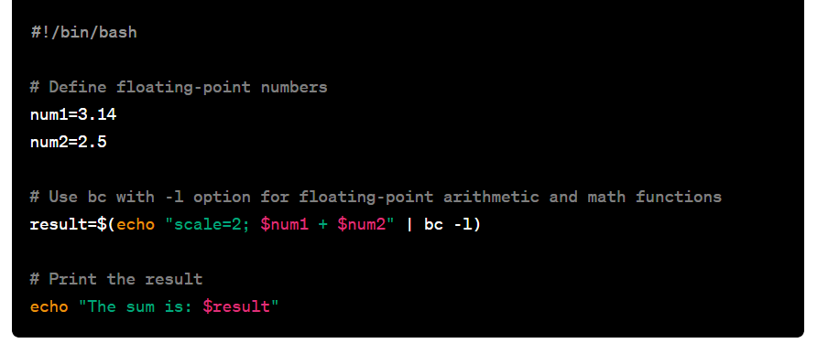
Floating Point Operation

Slide 15
Explanation
scale=2; sets the number of decimal places to 2 in the result. You can adjust the scale value based on your precision requirements.
echo "scale=2; $num1 + $num2" | bc -l performs the floating-point arithmetic with the specified precision.
Again, this is just a simple example. You can modify the expression within echo to perform other mathematical operations or use additional functions provided by the bc math library when using the -l option.
This output represents the result of the addition operation 3.14 + 2.5 with a scale of 2 decimal places, as specified in the scale=2 setting. The bc -l option allows for floating-point arithmetic and makes the math library available for use in the expression.

